Slide 1


Diamonds Price Prediction
To predict the diamond price within 15% difference*
Predicting price based on the required features of a diamond, for the purpose of budgeting or price references
* the difference (in percentage) between the actual and the predicted price

Slide 2
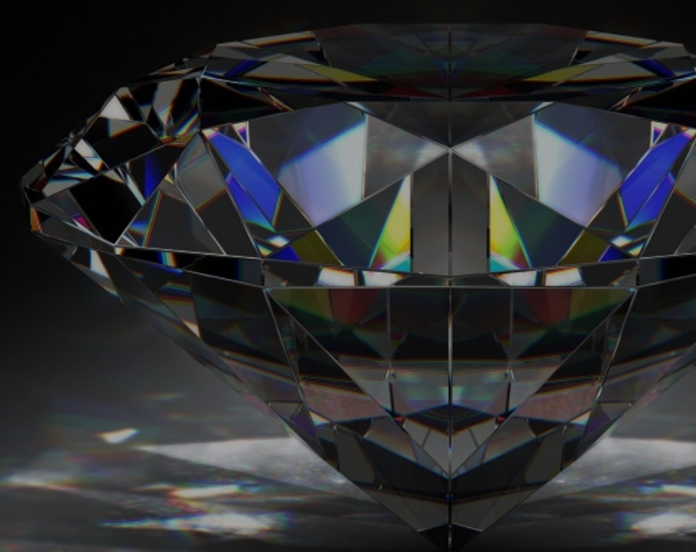
Contents
Data Characteristics
Exploratory Data Analysis (EDA) & Data Preparation
Features Selection
Models
Results
Feature Importance
Conclusion

Slide 3

Data Characteristics

Slide 4
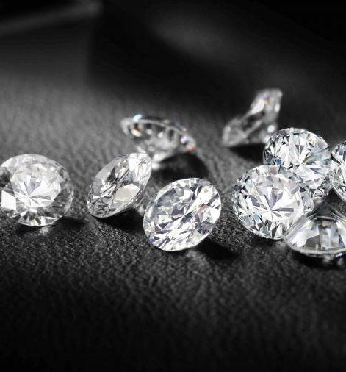
Data Source
Kaggle
More than 53,000 data on the measurements and price of diamonds
Diamond data:
Price
4Cs
Proportion and Measurements
Assumption:
Price = Sale price

Slide 5
4Cs
Carat
Color
Cut
Clarity

Slide 6
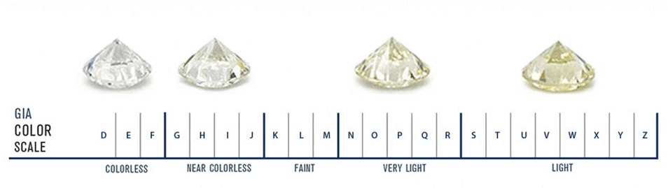
Carat
Weight of the diamond
Color
Color of the diamond with D (best) and Z (worst)
In the data, D to J.
Source: Petragems
Cut
Cut quality of the diamond
GIA classify as Excellent, Very Good, Good, Fair and Poor
In the data, Ideal (best), Premium, Very Good, Good and Fair (worst)

Slide 7
Clarity
Visible inclusions under 10X magnification
Symbol | Name
FL | Flawless
IF | Internally Flawless
VVS1/VVS2 | Very, Very Slightly Included
VS1/VS2 | Very Slightly Included
SI1/SI2 | Slightly Included
I1/I2/I3 | Included

Slide 8
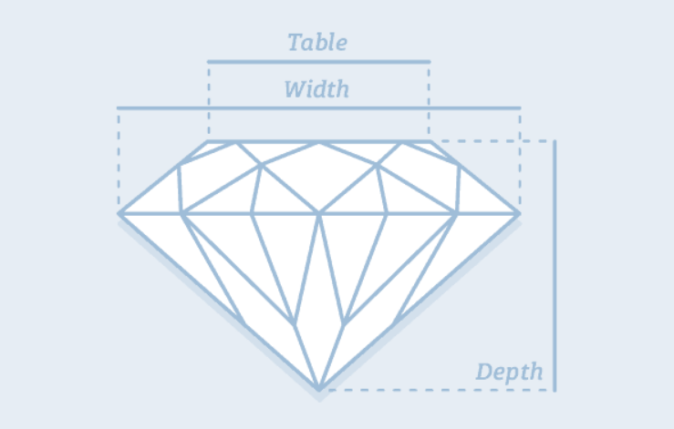
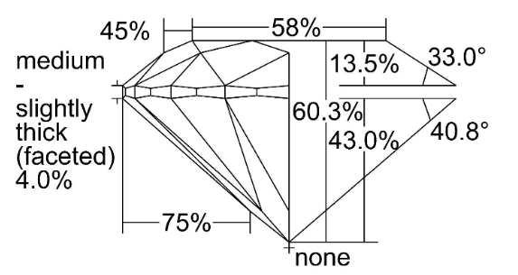
Proportion
Depth %
Measurement from top to bottom
Total height divided by total width (e.g. 60.3%)
Table %
Flat facet on diamond’s surface
Table width as a percentage of the total width (e.g. 58%)
Source: diamonds.pro
Source: GIA

Slide 9
Measurements
“X”
Length in mm
“Y”
Width in mm
“Z”
Depth in mm

Slide 10

Exploratory Data Analysis (EDA) & Data Preparation

Slide 11

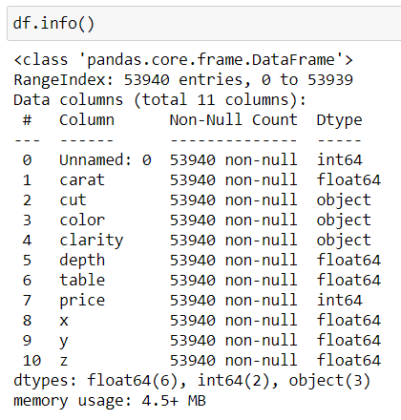
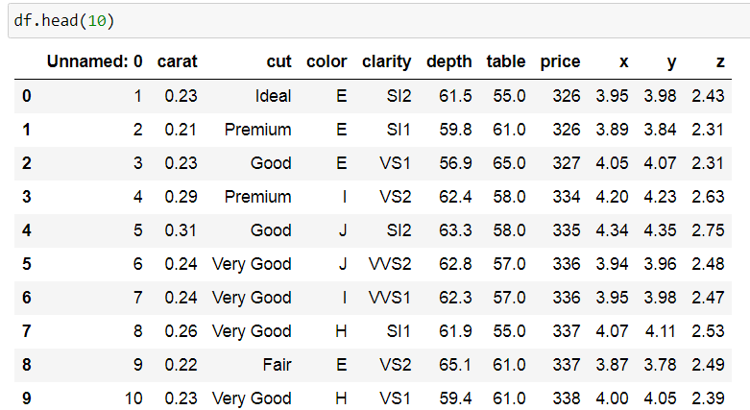
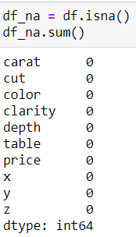
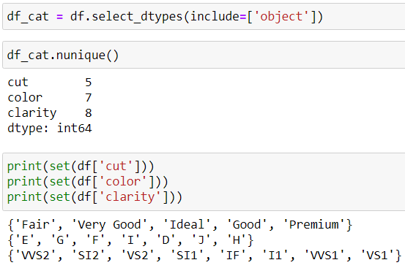
Looking at the data….

Slide 12
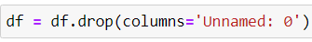
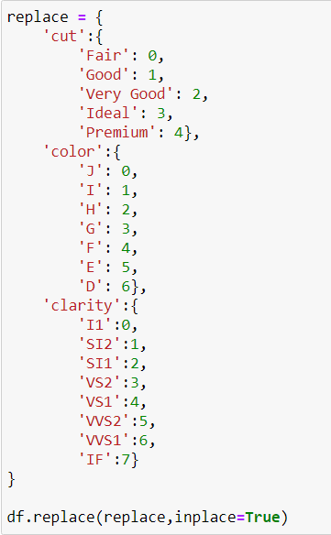
Dropping columns
Replacing the labels/objects into numerical form

Slide 13
Features Selection

Slide 14
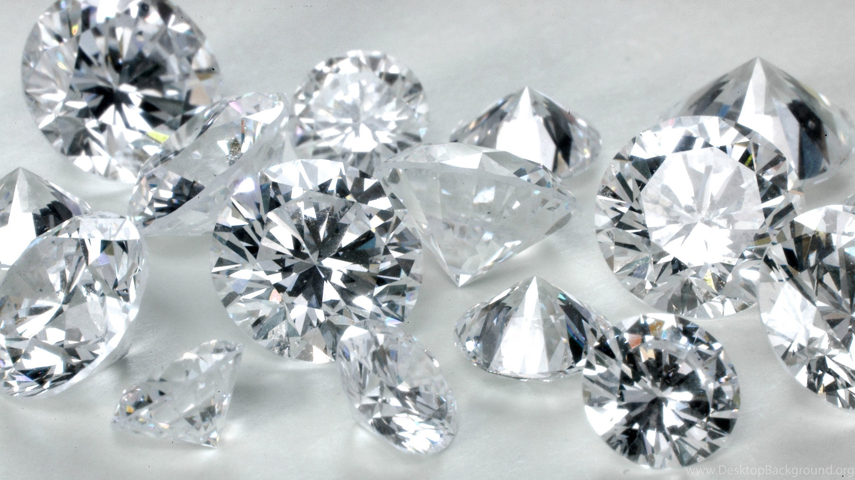
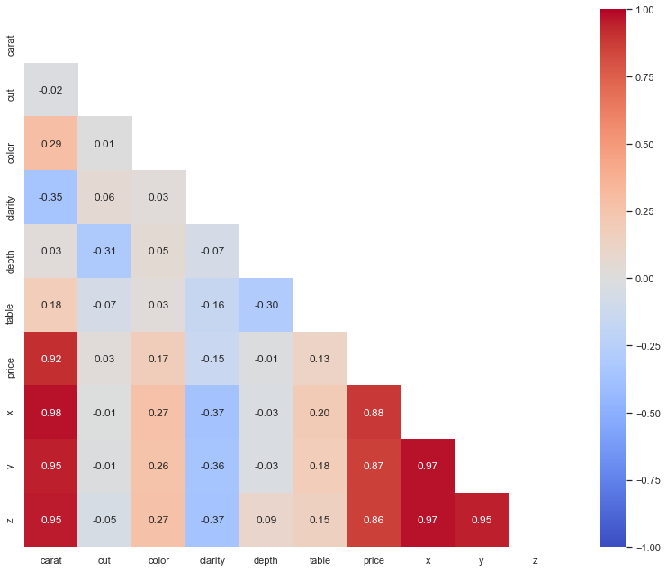
Correlation Map
Features Selected
Carat
Cut
Color
Clarity
Price
Depth, table, x, y and z are all measurements of a diamond. Thus, it is more relevant to drop these features and use only carat as a measurement feature.
Furthermore, the 5 features are more commonly used when selecting for a diamond.

Slide 15
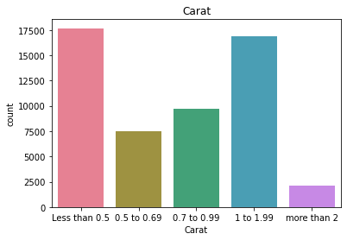
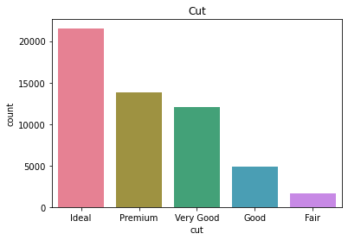
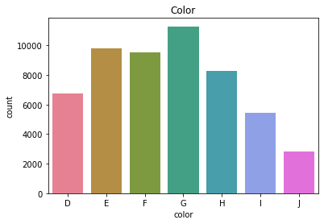
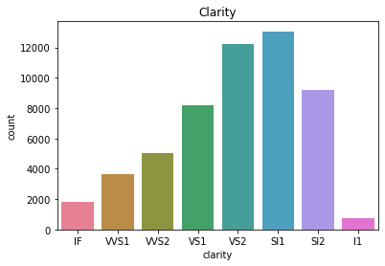
Visualizing the features

Slide 16
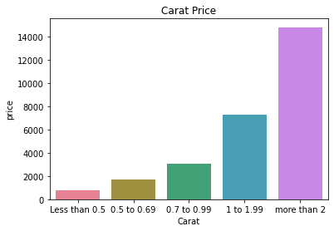
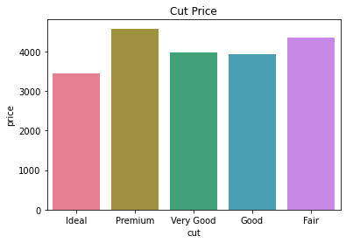
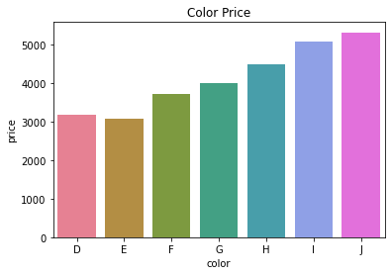
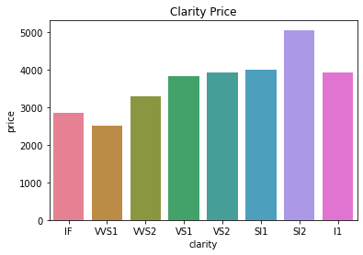
Visualizing the features

Slide 17
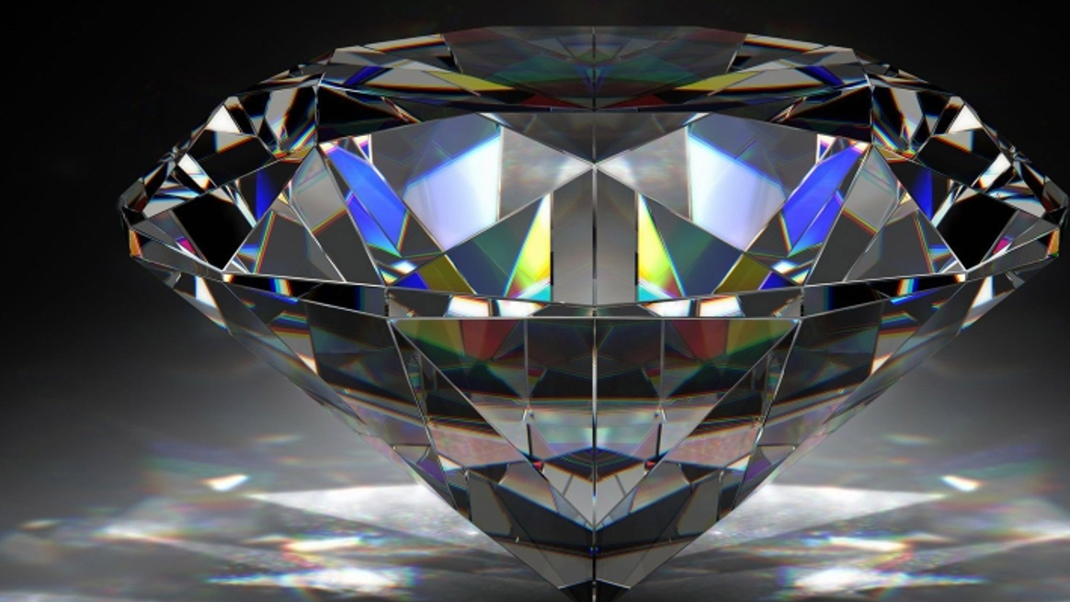
Models
Simple Linear Regression
Multiple Linear Regression
Random Forest Regressor

Slide 18
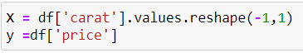
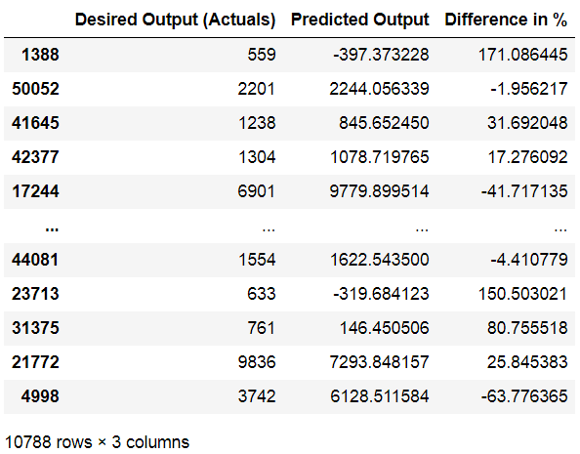
Simple Linear Regression
Models

Slide 19
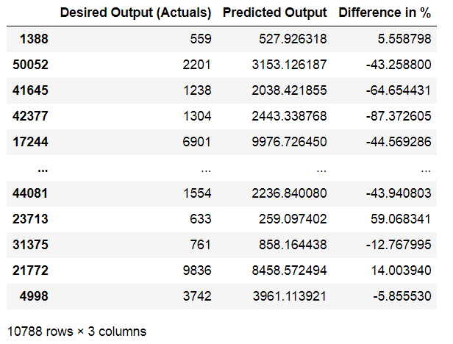
Multiple Linear Regression
Models
Independent features (X):
Carat
Cut
Color
Clarity

Slide 20
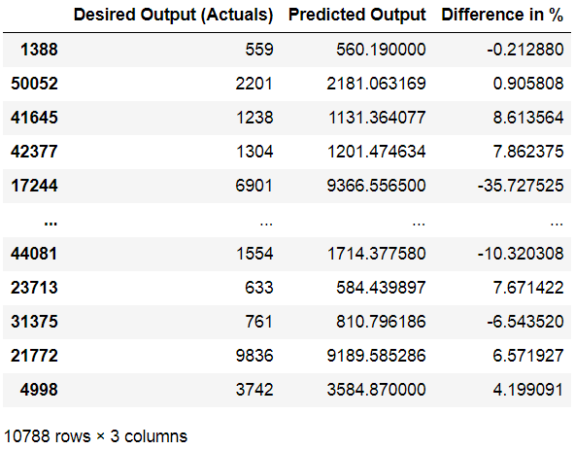
Random Forest Regressor
Models
Independent features (X):
Carat
Cut
Color
Clarity

Slide 21
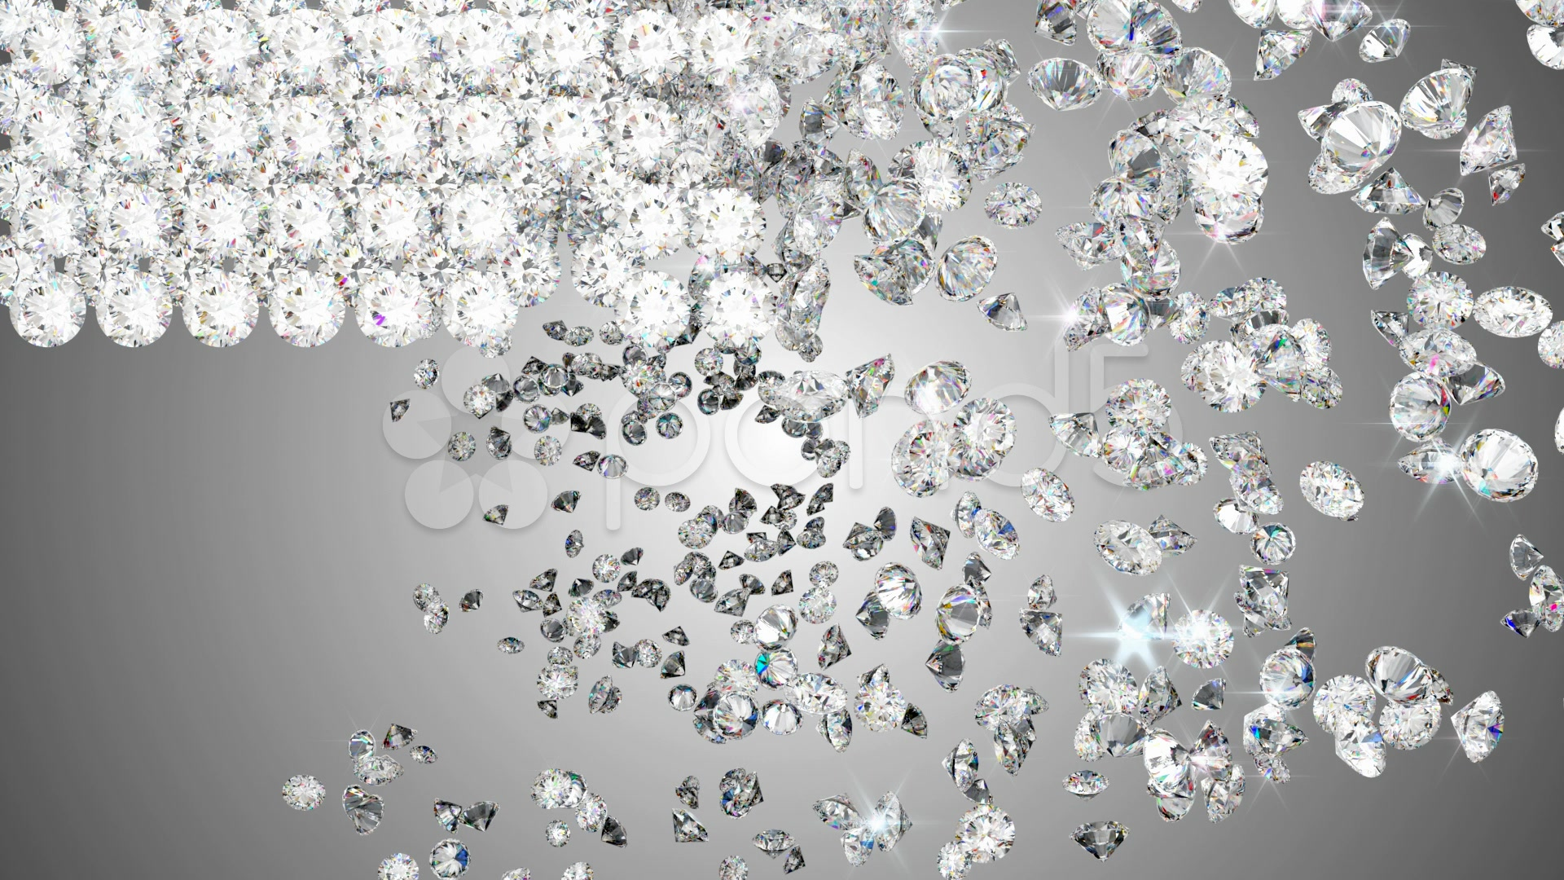
Results
 | Simple Linear Regression | Multiple Linear Regression | Random Forest Regressor
Mean Absolute Error (MAE) | 1009.50 | 855.90 | 297.20
Training score | 0.85 | 0.90 | 0.99
Test score | 0.85 | 0.90 | 0.98
Percentage of difference below 15% | 28.05% | 34.96% | 85.31%
Predicted Price (SGD) Carat: 1 Cut: Premium Color: E Clarity: VVS2 | 7,324.31 | 9,898.01 | 11,905.13

Slide 22
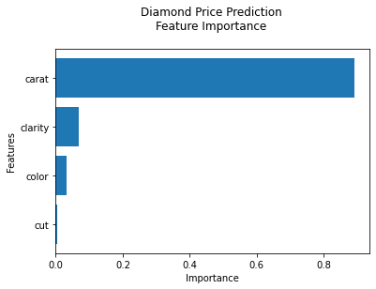
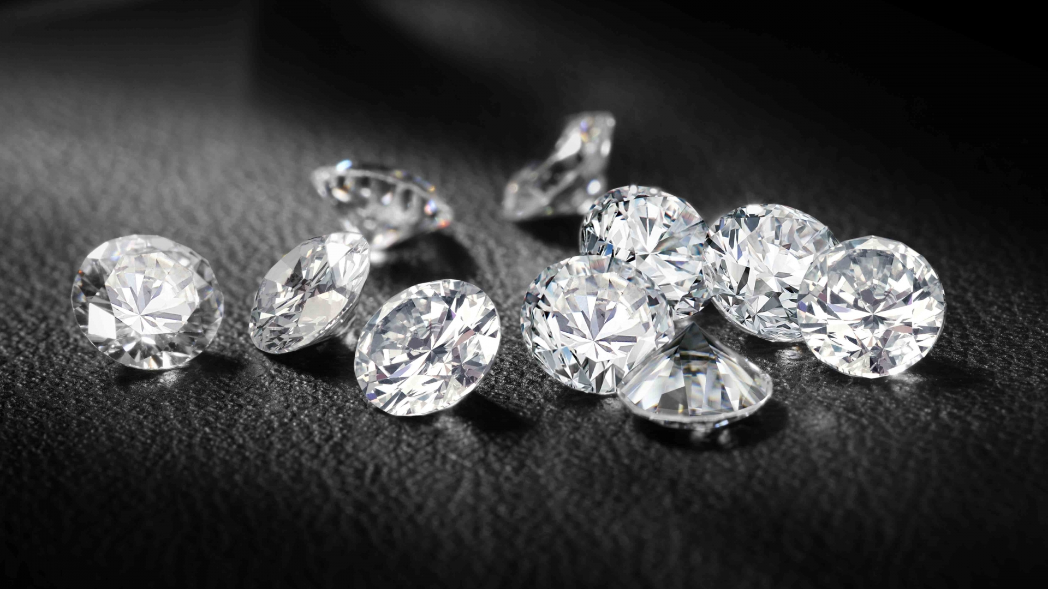
Feature Importance

Slide 23
Conclusion
Random Forest Regressor provides the highest test score and highest percentage of test data having difference of less than 15%
Although carat is the most important feature of the diamond price, we cannot solely based on carat to predict the diamond price (as evident in simple linear regression model)

Slide 24

References
Data Source:
https://www.kaggle.com/shivam2503/diamonds
Diamond information:
https://www.gia.edu/report-check?reportno=6245697081
https://4cs.gia.edu/en-us/diamond-clarity/
https://www.diamonds.pro/education/diamond-depth-and-table/
https://www.petragems.com/education/diamond-color/

